Slide 1





SMART FARMING INSIGHTS AND CHATBOT- BASED DECISION SUPPORT USING DATA ANALYSIS
PRESENTATION 2026
Student Name
Student Email
Niharika Nagwanshi
niharikanagwanshi244@gmail.com
Mentor Name
P Raja SIr

Slide 2

Outline
Abstract of the Project
Problem Statement
Proposed Solution
System Architecture
Live Demo of the Project
Embedded Video of Project
Conclusion
Future Scope

Slide 3
Abstract
This project, Smart Farming Insights And Chatbot- Based Decision Support Using Data Analysis, focuses first on developing an interactive dashboard to visualize agricultural data and generate meaningful insights for better decision-making. Using Microsoft Power BI, the dashboard presents key metrics such as sales trends, demand–supply patterns, pricing variations, seasonal performance, and customer feedback, helping users easily understand complex data.
The dataset used in this project consists of agricultural product sales data with over 8000+ rows and 17 columns, including details like product category, price, sales, inventory, supplier information, and customer ratings. The data was cleaned and preprocessed using Microsoft Excel to remove inconsistencies and enhance analysis quality.

Slide 4
The main objective of the project is to identify challenges such as demand–supply mismatch, pricing fluctuations, seasonal variations, and customer feedback issues, and address them using data-driven approaches. The project utilizes tools and technologies such as Microsoft Excel for data cleaning, Microsoft Power BI for visualization, and Microsoft Copilot Studio for developing an AI-powered chatbot (AgriPluse) that provides real-time guidance and recommendations.
The expected outcomes include a clean and structured dataset, an interactive dashboard for visual insights, and an intelligent chatbot that simplifies complex data into easy-to-understand recommendations. Key highlights of the project include the integration of AI with data analytics, a user-friendly chatbot interface, and support for digital transformation in agriculture by enabling non-technical users to make informed decisions efficiently

Slide 5

Problem Statement
The core problem addressed in this project is the lack of data-driven decision-making in agriculture and small businesses, leading to issues such as demand–supply mismatch, pricing instability, seasonal inefficiencies, and inconsistent customer feedback.
This problem is significant because it directly affects productivity, profitability, and resource utilization. Farmers and small business owners often rely on traditional methods, making it difficult to analyze large datasets and identify meaningful patterns.

Slide 6
The primary users affected are farmers, agri-business owners, and small-scale entrepreneurs who need simple and effective tools to improve their operations and decision-making.
Existing approaches mainly depend on manual analysis with limited use of dashboards or AI tools, which makes the process time-consuming and less accurate. There is also a lack of user-friendly systems that non-technical users can easily understand and use.
The scope of this project is limited to analyzing a structured agricultural dataset and providing insights through a Power BI dashboard and an AI chatbot. It does not include real-time data integration or large-scale deployment but focuses on creating a smart, accessible decision-support system

Slide 7
Objectives
Data Preparation & Understanding: To collect, clean, and preprocess the agricultural dataset by removing inconsistencies and analyzing key variables like product category, price, sales, shipment, inventory, and customer ratings.
Analysis of Demand, Performance & Quality: To examine demand–supply gaps, pricing and revenue trends, seasonal and location-wise performance, and customer feedback to identify inefficiencies and improve product quality and sales.
Smart Decision Support System: To develop an interactive dashboard and integrate an AI chatbot to deliver real-time insights, enabling data-driven decisions and promoting digital transformation in agriculture.

Slide 8

Proposed Solution
The proposed solution is a smart system that combines data analysis and an AI chatbot to solve agricultural challenges. The dataset is cleaned using Microsoft Excel and visualized in Microsoft Power BI through the Farm Sales and Operation Dashboard, showing key insights like demand–supply gaps and pricing trends.
An AI-powered chatbot (AgriPluse) built using Microsoft Copilot Studio provides structured insights and recommendations to users in a simple way.
This solution helps improve decision-making, reduce losses, and promote digital adoption among farmers and small businesses.

Slide 9
System Architecture
Data Input / Source
Processing / Analysis
Data sourced from Kaggle, enhanced using ChatGPT by adding columns like digital tools usage and customer ratings, and further cleaned for accurate analysis.
The dataset was cleaned, transformed, and analyzed using Microsoft Excel by handling missing values, adding new columns, and creating charts for insights.
AI / Tool Integration
Output / Dashboard
Microsoft Excel is used for data cleaning and preparation, while Microsoft Power BI creates the Farm Sales and Operation Dashboard for visual insights and an AI chatbot (AgriPluse) built using Microsoft Copilot Studio provides simple, real-time recommendations and insights to users.
The final output includes an interactive Farm Sales and Operation Dashboard created using Microsoft Power BI, along with clear charts and visual insights. It also features an AI chatbot (AgriPluse) that provides simple, structured recommendations and insights based on the analyzed data.

Slide 10
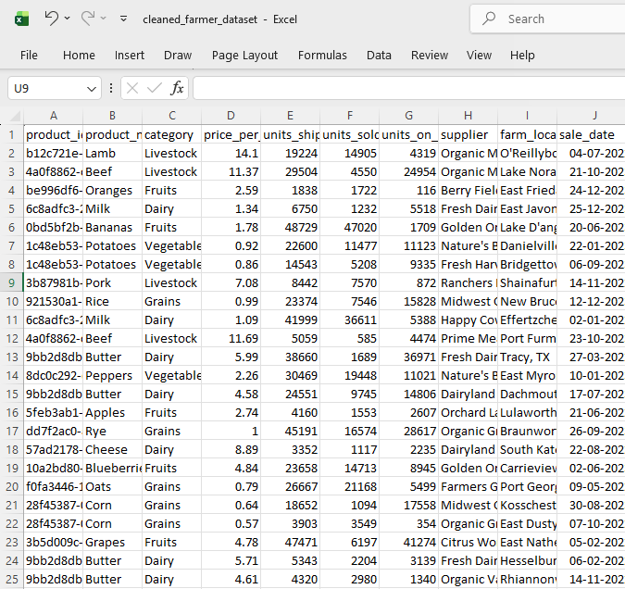
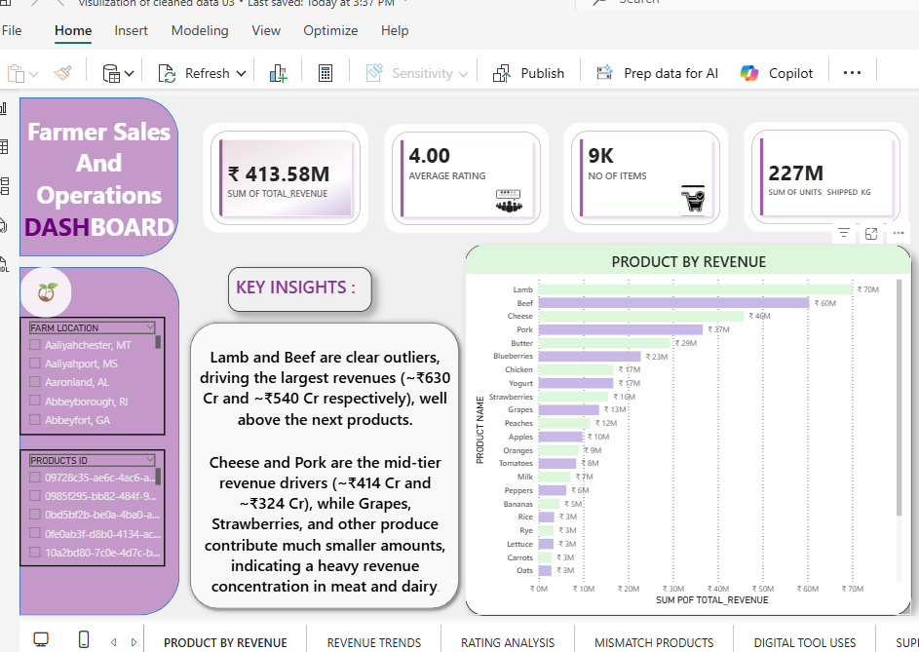
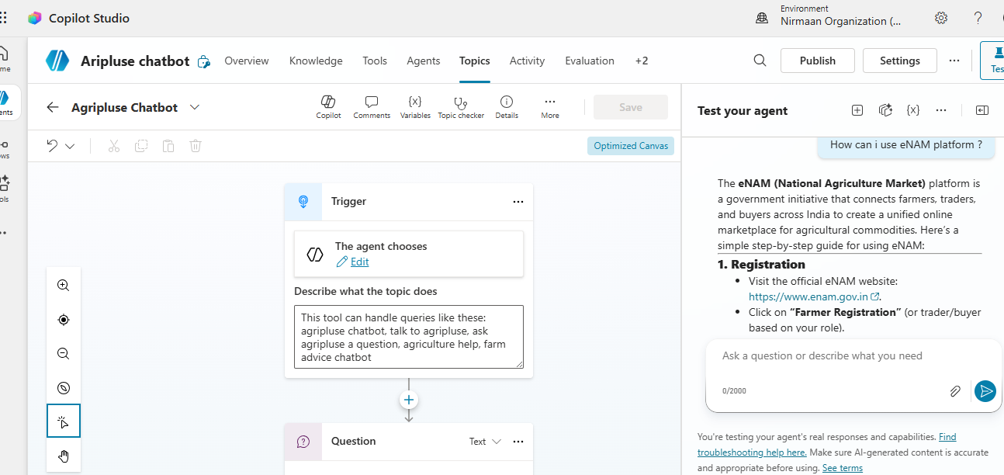
Live Demo of Project
Here's the list of some demo screenshots / features of the project:
Demo 1
Demo 2
Demo 3
]

Slide 11
Video of Project Demo
https://drive.google.com/file/d/1kJAaRM9h3AgR6p7cZAjusNtX8cjisyuZ/view?usp=drive_link
▶
[Insert your project demo video.
You can embed a video your live project.]

Slide 12

Conclusion
This project developed a smart decision-support system using data analysis and an AI chatbot. The Farm Sales and Operation Dashboard provided key insights like demand–supply gaps and pricing trends.
The AI chatbot (AgriPlus) delivered simple recommendations, helping users make better decisions. Overall, the project achieved its objectives and supports digital adoption in agriculture.
CONCLUSION

Slide 13

Future Scope
In the future, this project can be enhanced by adding real-time data integration and predictive analytics for more accurate decision-making. The AI chatbot (AgriPlus) can be improved with advanced features like voice support and multilingual interaction.
The system can also be developed into a mobile or web application to make it more accessible for farmers and small businesses, increasing its real-world impact.

Slide 14
Thank You
AICW Fellowship | Student Project Presentation 2026
LinkedIn | Edunet Foundation

